Slide 1
Smartwatch Teardown
24th January 2024
Notes:
Good morning, everyone. Happy to finally see all you in person after 2 years of travel restriction due to covid.

Slide 2
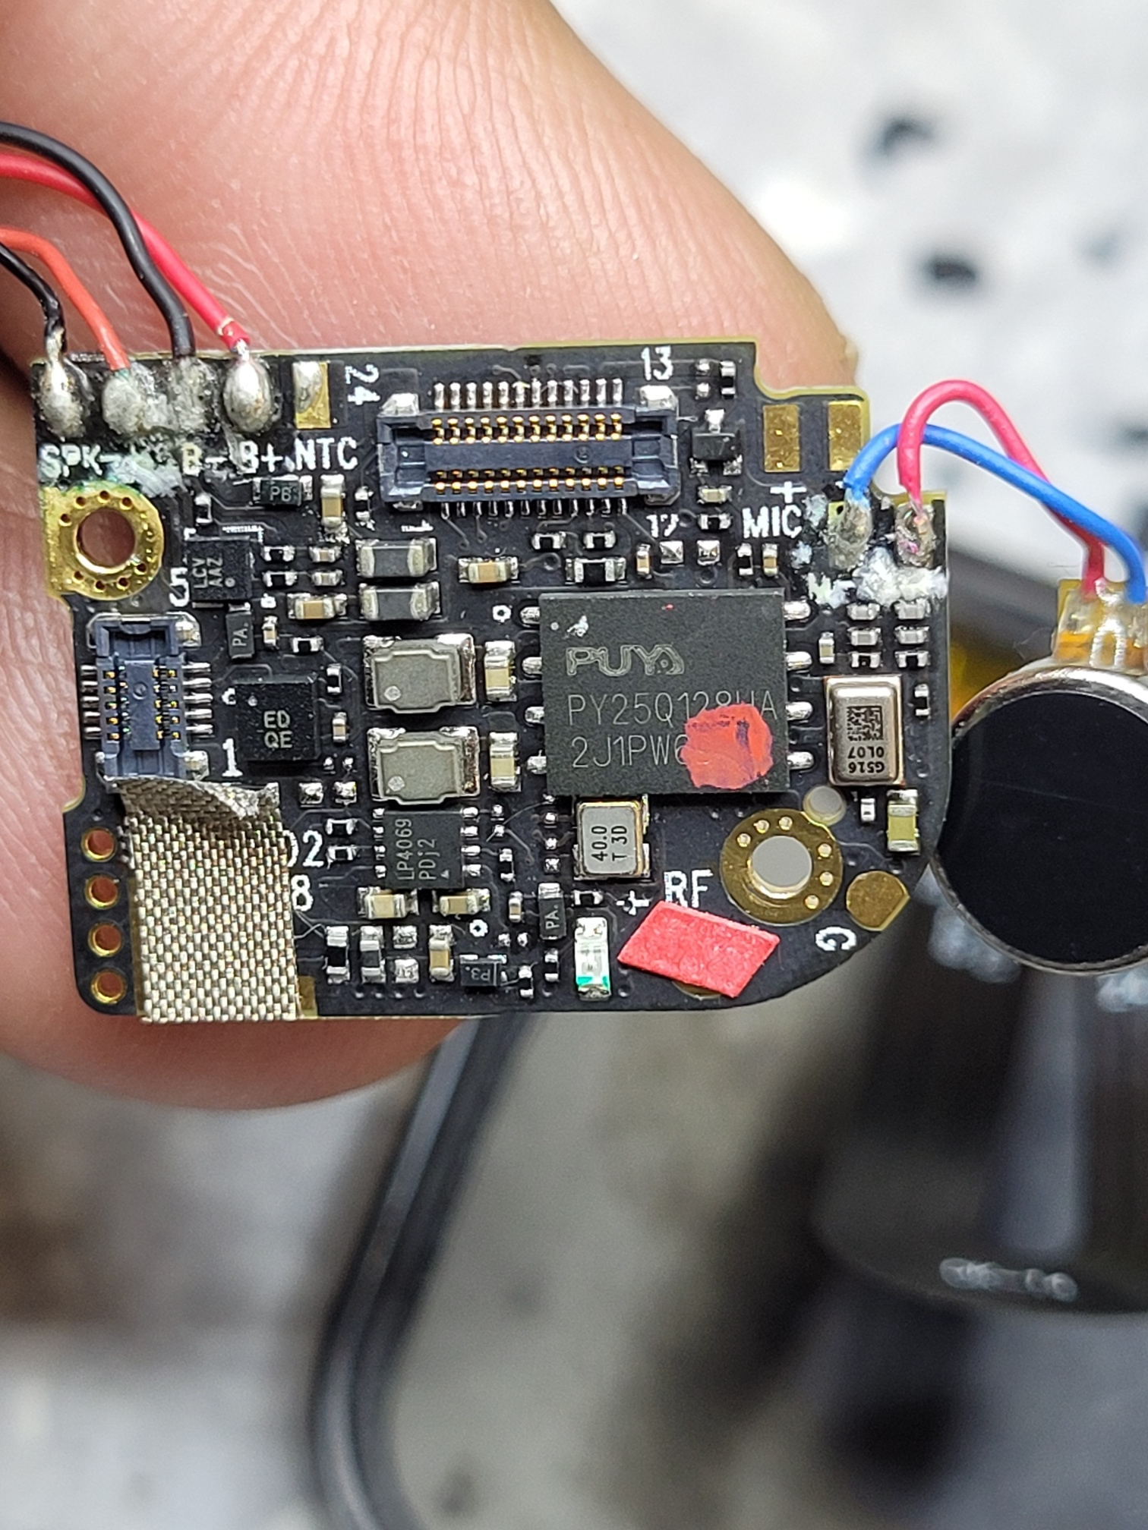
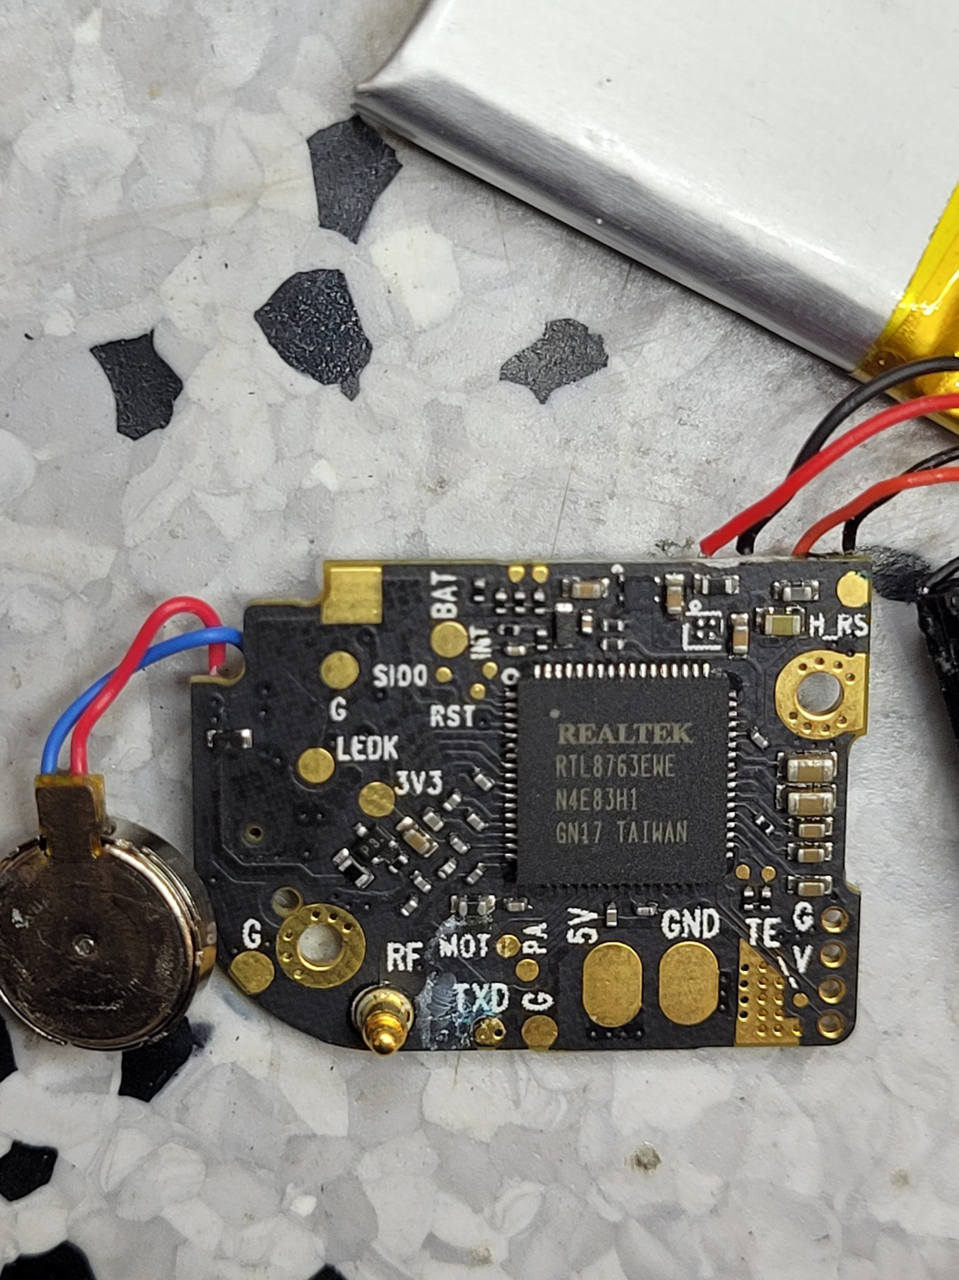
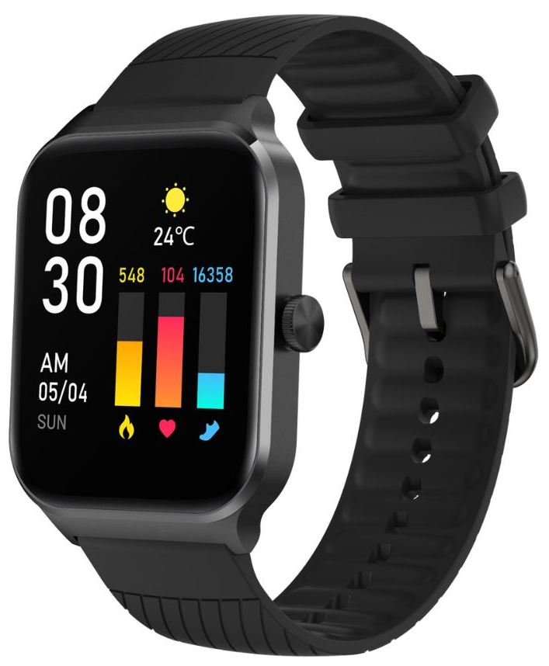
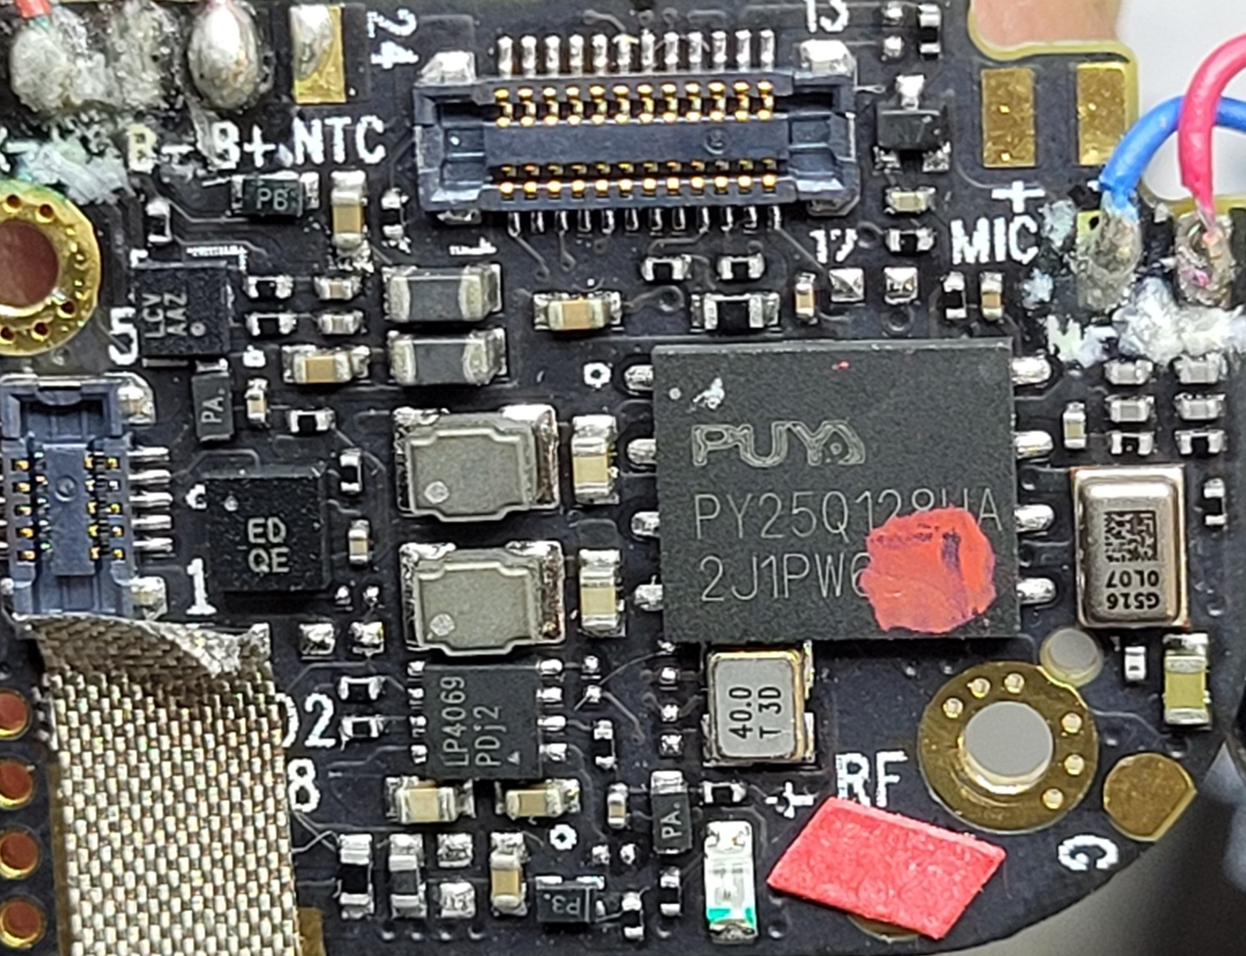
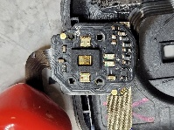
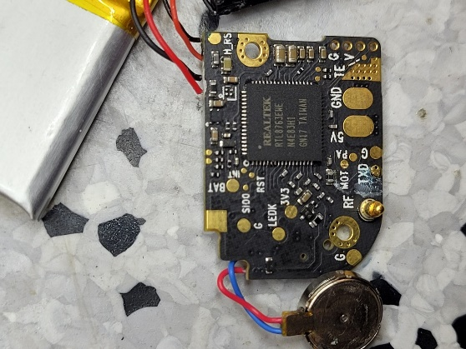
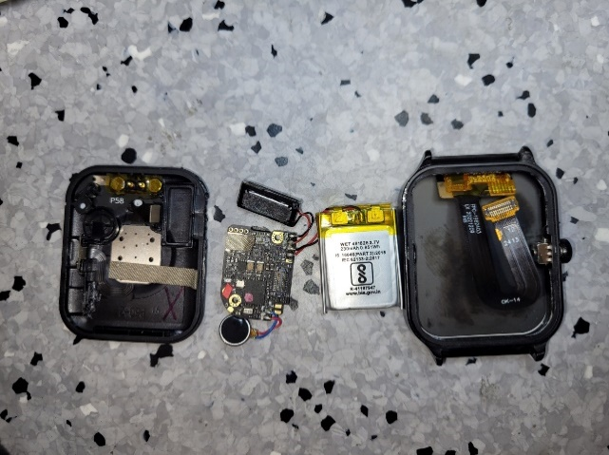
Smartwatch Model -1 : Noise Colorfit Canvas
Smart watch Specifications
Details found after Teardown
Model | Noise Colorfit Canvas Price : INR2050(~$24.6) Segment : Mid-end Expected BOM Cost : ~$17 | Watch Image
Watch Features | AI Voice assistance, Heart rate monitor, SpO2 monitor, Stress monitor Step tracker, Calories burned, Distance travelled, Activity history, Sleep monitor, Breathe exercise & 100+ Sports modes, Find my phone, Low Battery reminder, Remote music control Remote camera control Stopwatch, Timer and Alarm, Weather forecast, Wake gesture, Vibration alert, Do not disturb mode, Bluetooth Calling, Caller name information & Call rejection
Battery | Charge time - less than 2 Hrs Battery Life - Upto 7 Days in normal mode & Upto 2 Days battery with calling Charge Type - USB cable with Metallic Charging Point (POGO Type)
Manufactured by/EMS | IL Jin Electronics India Pvt Ltd.
Processor | BLE SoC (Realtek RTL8763E) Connectivity: Bluetooth 5.2 Note: Realtek RTL8763E is a 2-in-1 solution for Smartwatch & TWS(Supports BLE Data, Classic Audio, BLE Audio)
Display | Size : 1.75”(4.44 cm) Technology : TFT LCD 2.5D curved glass display with touch
Memory | 128Mbit | PUYA Semiconductors(Shanghai, China) P.No. – PY25Q128HA Serial NOR Flash
PMIC | LP Semi LP4069 | Linear Charger for Li-Battery
Sensor | Unknown Make PPG Sensor. It has 4x LEDs (2x Transmitter + 2x Receiver). It does not have dedicated Bioprocessor.
Teardown Images
Next A.I. : Teardown other H/E models of Noise

Slide 3
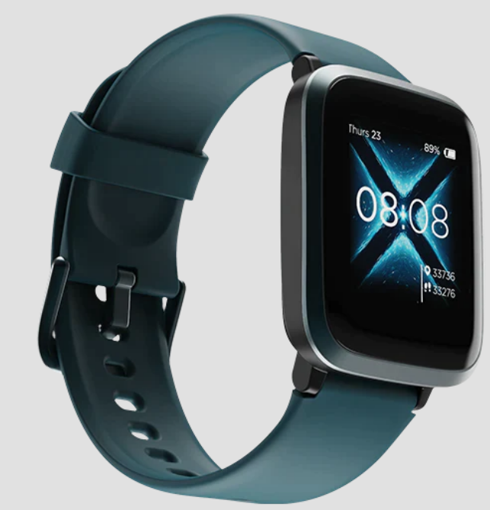
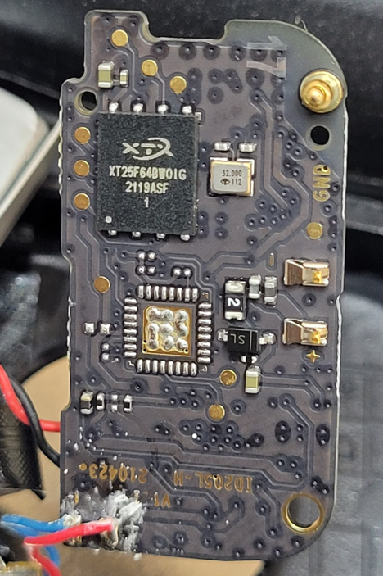
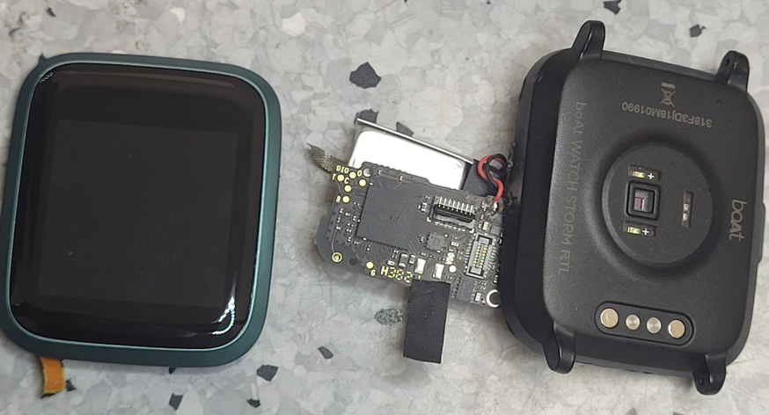
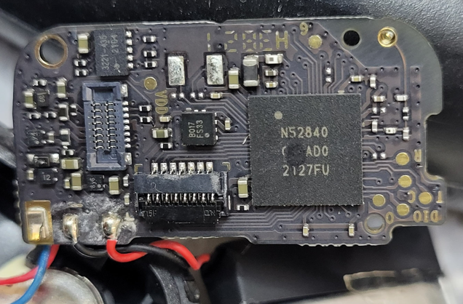
Smartwatch Model -2 : boAt Storm RTL
Smart watch Specifications
Details found after Teardown
Model | boAt Storm RTL Price : INR3499(~$41.95) Segment : Mid-end Expected BOM Cost : ~$17 | Watch Image
Watch Features | Heart rate monitor, SpO2 monitor, BP monitor, Guided breathing mode, Water proof Smart activity tracker for calories, steps & distance. Storm RTL comes with 9 Active Sports Modes: Running, Walking, Cycling, Hiking, Climbing, Fitness, Treadmill, Yoga and Dynamic Cycling
Battery | Charge time – 2.5 Hrs Battery Life – 8 - 10 Days Charge Type - USB magnetic cable with direct charging
Manufactured by/EMS | IL Jin Electronics India Pvt Ltd.
Processor | BLE SoC (Nordic N52840) Connectivity: Bluetooth 4.2 Note: Realtek RTL8763E is a 2-in-1 solution for Smartwatch & TWS(Supports BLE Data, Classic Audio, BLE Audio)
Display | Size : 1.29”(3.3 cm) Technology : TFT LCD 2.5D curved glass display with touch
Memory | 128Mbit | PUYA Semiconductors(Shanghai, China) P.No. – PY25Q128HA Serial NOR Flash
PMIC | LP Semi LP4069 | Linear Charger for Li-Battery
Sensor | Unknown Make PPG Sensor. It has 4x LEDs (2x Transmitter + 2x Receiver). It does not have dedicated Bioprocessor.
Teardown Images
Next A.I. : Teardown other H/E models of Noise

Slide 4
Smartwatch Model -3 :
Smart watch Specifications
Details found after Teardown
Teardown Images

Slide 5
Thank You !!

